Slide 1
Name: Anongo Benjamin Zahemen
File Name: retail_store_sales.csv
Source of data: Kaggle
Data description: The Retail Store Sales dataset contains 12,575 rows of synthetic data representing sales transactions from a retail store. The dataset includes eight product categories with 25 items per category, each having static prices. It is designed to simulate real-world sales data.
Number of Rows: 12,575
Number of Columns: 11
Data URL link:https://www.kaggle.com/datasets/ahmedmohamed2003/retail-store-sales-dirty-for-data-cleaning
Data source: Kaggle

Slide 2
Columns:
The dataset has 11 columns: Transaction ID, Customer ID, Category, Item, Price Per Unit, Quantity, Total Spent, Payment Method, Location, Transaction Date, and Discount Applied.
The raw dataset contained 7,229 empty cells, with the most affected columns being Discount Applied, Item, and Price per Unit.
Missing and inconsistent data were handled by replacing empty cells with zeros and using logical formulas to fill or calculate missing values in Price Per Unit, Quantity, Total Spent, and Discount Applied. Typographical inconsistencies were corrected by standardizing text formatting. No outliers were found, indicating the dataset is clean, consistent, and ready for analysis.

Slide 3
Research Questions
(1.) Which product categories generate the highest total sales revenue, and how does this vary across locations?
(2.) How does the application of discounts affect total spending and sales quantity?
(3.) What payment methods are most commonly used by customers, and do they vary by location or category?
Analysis Method
Product categories vs. total sales - Comparative Analysis
Effect of discounts on purchases and revenue -Comparative Analysis
Payment methods by location - Comparative Analysis

Slide 4
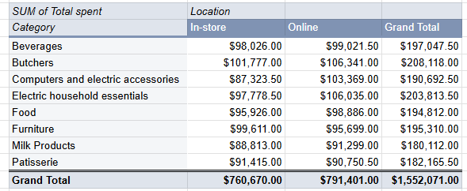
Q1.Table

Slide 5
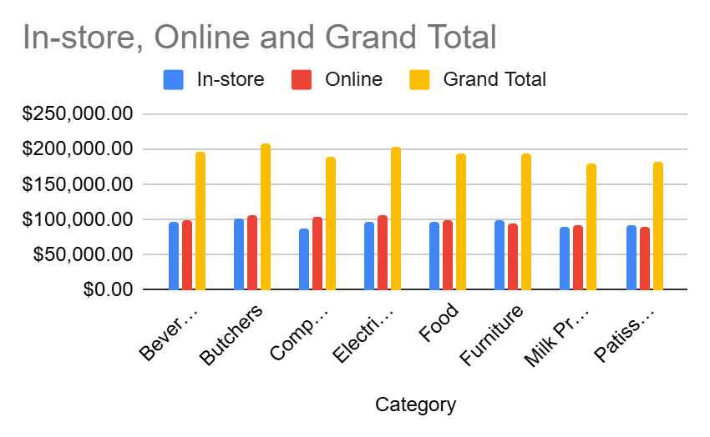
Q1. Summary(charts)

Slide 6

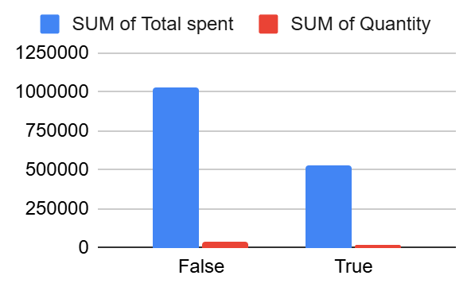
Q2. Table and charts

Slide 7
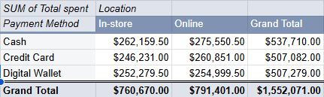
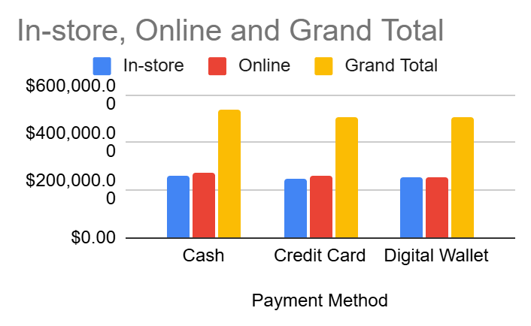
Q3 Table and charts

Slide 8
Summary of my findings
(Q1) Online sales ($791,401) are slightly higher than in-store sales ($760,670). The Butchers category recorded the highest total sales ($208,118), while Milk Products had the lowest ($180,112).
Why it matters: This shows that online sales channels slightly outperform physical stores, suggesting stronger customer engagement and convenience in online shopping.
Conclusion: The retail store should continue strengthening its online platform while maintaining in-store operations for high-performing categories like Butchers and Electric household essentials.
(Q2) Transactions without discounts generated higher total sales ($1,027,627.50) and quantities (44,037) compared to discounted sales ($524,443.50 and 22,239).
Why it matters: This indicates that offering discounts did not necessarily boost sales or revenue — customers purchased more even without discounts.
Conclusion: Discounts may not be driving additional sales and could be reducing profit margins. The store should review its discount strategy to focus on high-impact promotions or product-specific discounts.

Slide 9
(Q3)
Cash is the most used payment method ($537,710), followed closely by Digital Wallets and Credit Cards. Online purchases ($791,401) slightly exceed in-store sales ($760,670). This shows customers value both cash and digital payment options.
Why it matters: Understanding these preferences helps improve payment flexibility and customer experience.
Conclusion: Maintain cash options but promote digital wallets to enhance convenience and support future growth.

Slide 10
Limitations and future work
Limited time period restricts trend and seasonality analysis → include more dates.
Sample may not fully represent all customers → expand dataset.
Missing variables (demographics, store details) → collect additional data.
Data entry errors affect accuracy → ensure clean, validated records.
External factors like promotions not considered → analyze impact of marketing and seasonal events.

